Slide 1
Optimal Solution of
Rare Pose Detection
산업 수학 프로젝트
POSE!
강채원 한창헌
이재협 김혜미

Slide 2
CONTENTS
01
Pose Estimation
02
Maximum Likelihood Estimate
03
FB8 Distribution
04
Pose Rareness

Slide 3
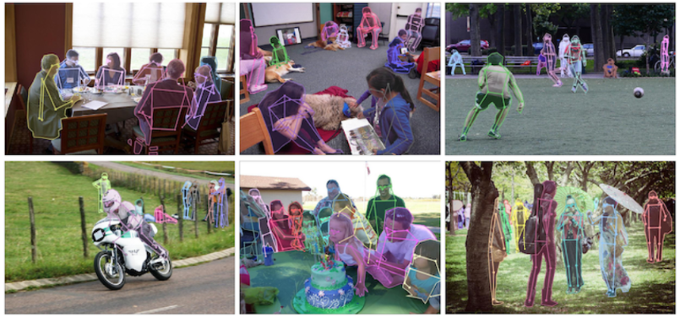
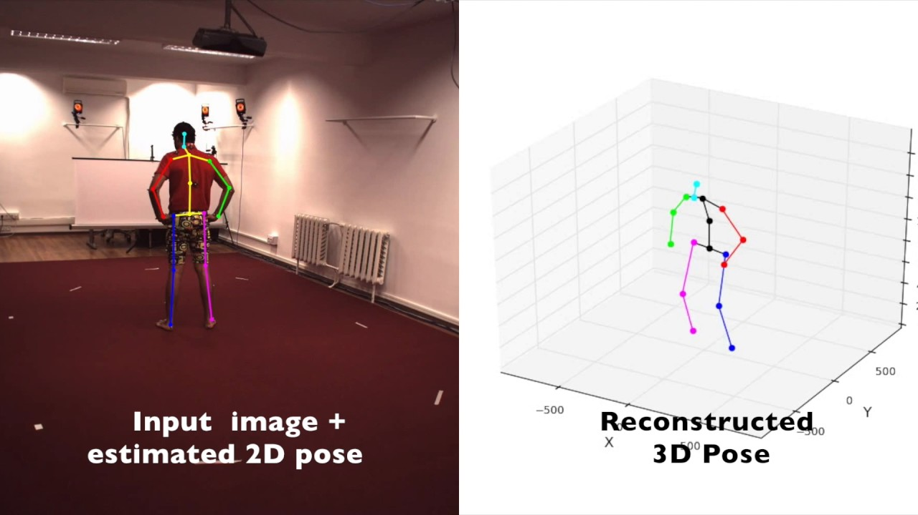
01
Pose Estimation
- 컴퓨터 비전에서 객체의 위치와 방향을 탐지하는 것은 일반적인 문제이다.
Pose Estimation은 사람의 신체 관절인 키포인트가 어떻게 구성되어 있는지 위치를
측정하고 추정하는 문제이다.
- Pose Estimation은 2D Pose Estimation, 3D Pose Estimation이 있다.
- 주요 키포인트는 Head, Neck, Shoulder, Elbow, Wrist, Hip, Knee, Ankle 등이 있다.
- 최근 이러한 문제는 머신러닝을 통해서 풀고있다.

Slide 4
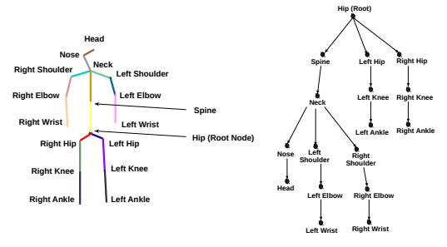
01
Pose Estimation - Keypoint

Slide 5
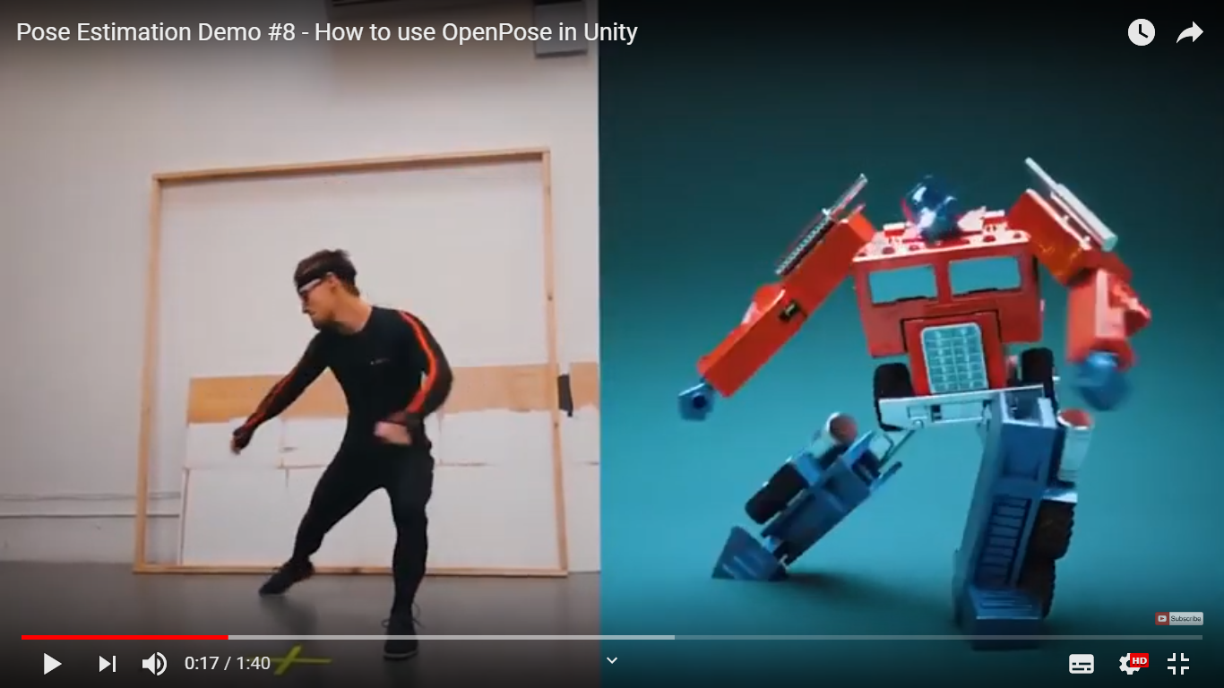
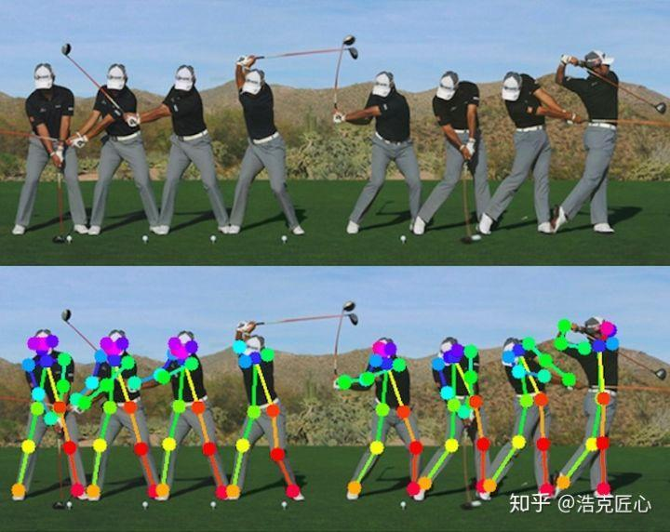
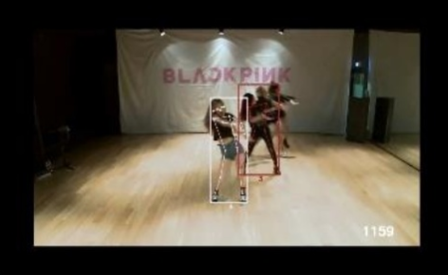
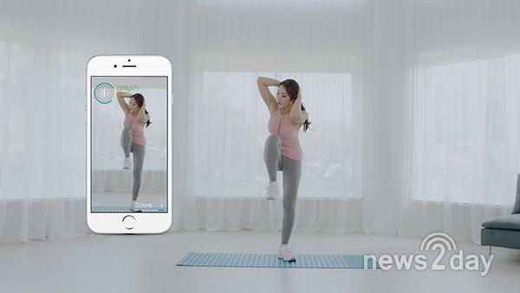
01
Use of 3D Pose Estimation

Slide 6
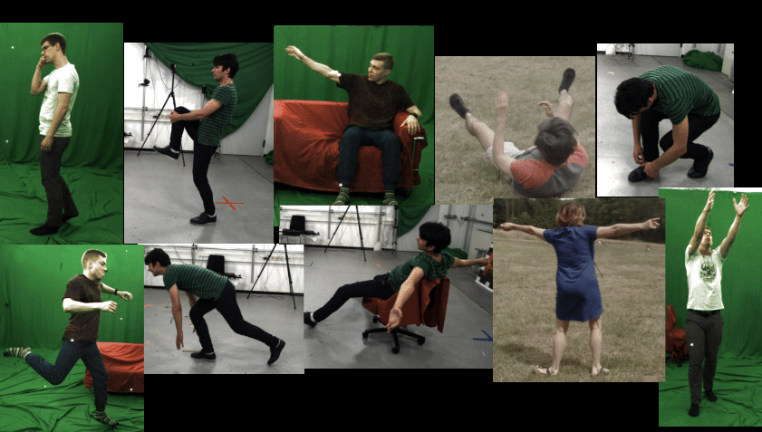
01
Pose Estimation – (3D Dataset)
Pose Estimation (3D Dataset)
MPI-INF-3DHP

Slide 7
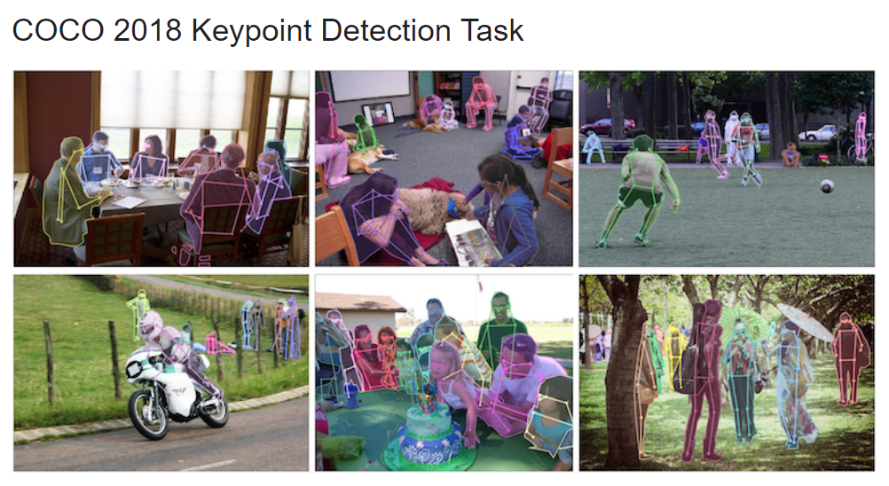
01
Pose Estimation – (2D Dataset)

Slide 8
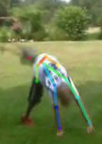
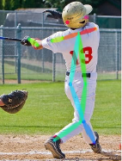
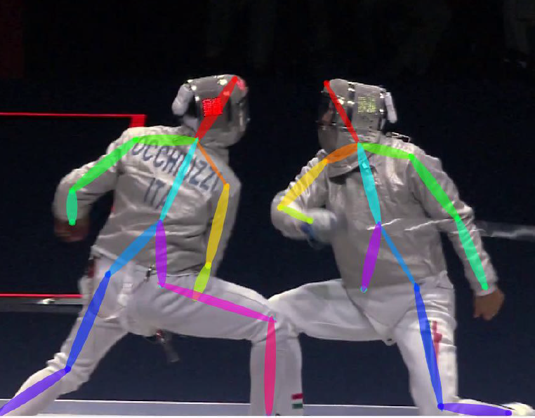
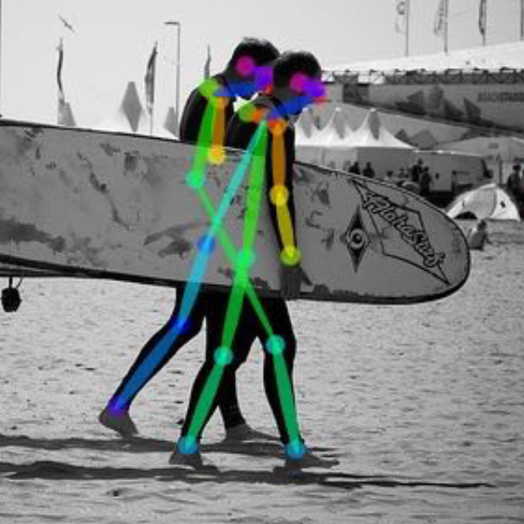
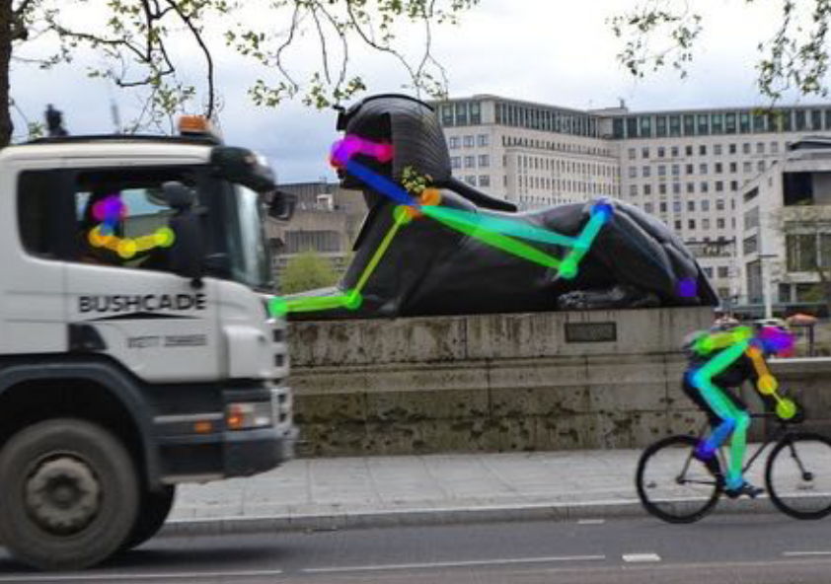
01
Pose Estimation – ERROR
Rare Pose
Missing Parts
Overlap Parts
Wrong Connection parts
Animal or Statues

Slide 9
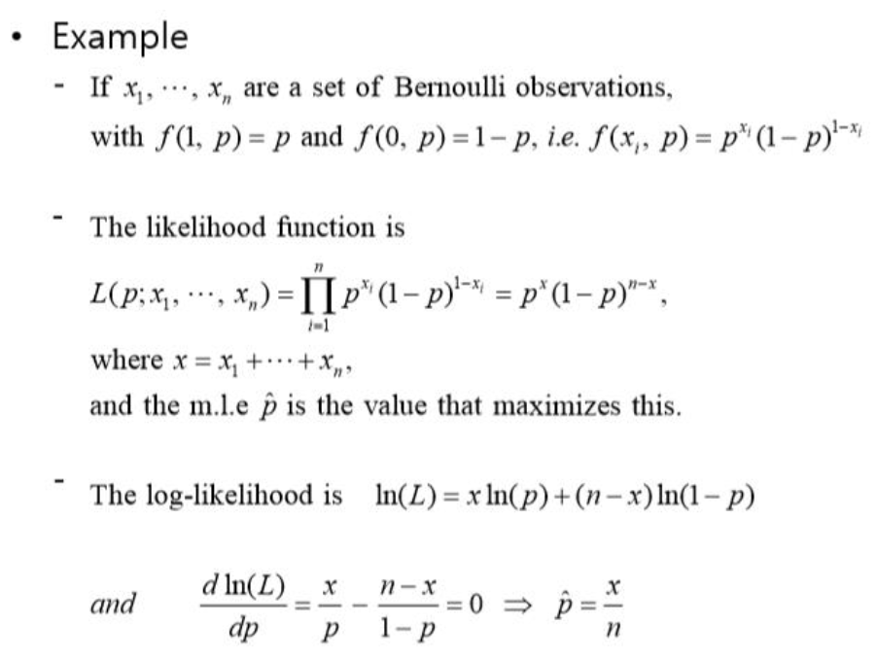
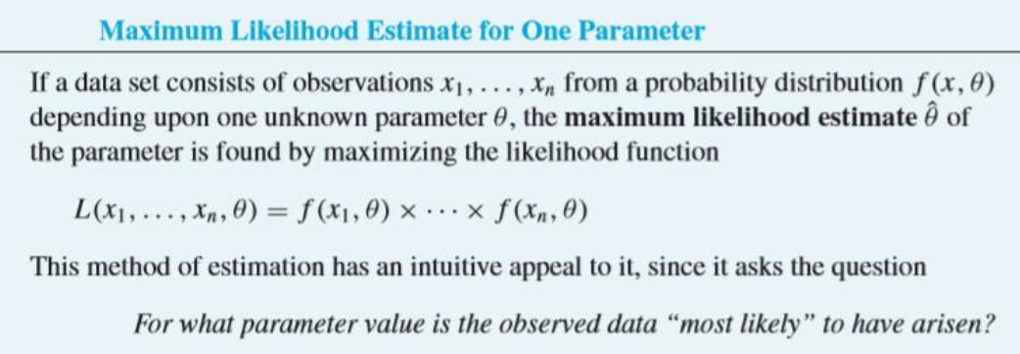
02
Maximum Likelihood Estimate

Slide 10


FB5 ( )
FB6 ( )
03
FB8 Distribution
Notes:
eq1 : f(\mathrm{x};\Theta) \propto \mathrm{exp}\{\kappa\gamma_1^T\mathrm{x}\}
\begin{gather}
\gamma_1 \space = \space mean\space vector, \space \space\gamma_2 \space = \space major \space axes, \space \space\gamma_3 \space = \space minor \space axes, \\
\kappa\space=\space concentration, \space \beta\space = \space ovalness \space of \space the\space the \space distribution
\end{gather}

Slide 11
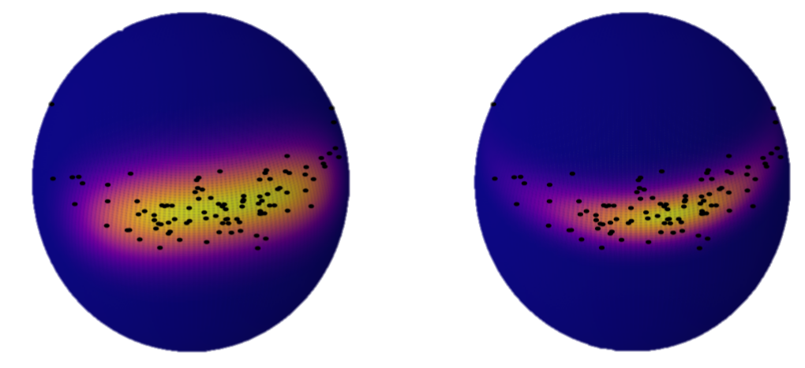



FB8 (Combining the vMF and FB6)
03
FB8 Distribution
Figure : Maximum likelihood fit of synthetic dataset(black points) using (left) and (right).
The best-fit parameters for each distribution are indicated in the underlying text. The data is better described by the distribution.
Notes:
f_6(\vec{x}) = c_6(\kappa, \beta,\eta)^{-1} exp{\{ \kappa\vec{\gamma_1}}\vec{x} + \beta[(\vec{\gamma_2}\vec{x})^2 - \eta(\vec{\gamma_3}\vec{x})^2]\}
eq1 : f(\mathrm{x};\Theta) \propto \mathrm{exp}\{\kappa\gamma_1^T\mathrm{x}\}
\begin{gather}
\gamma_1 \space = \space mean\space vector, \space \space\gamma_2 \space = \space major \space axes, \space \space\gamma_3 \space = \space minor \space axes, \\
\kappa\space=\space concentration, \space \beta\space = \space ovalness \space of \space the\space the \space distribution
\end{gather}
f_8(\vec{x}) = c_8(\kappa, \beta, \eta,\vec{v})^{-1} exp\{\kappa(\Gamma\vec{v}-\vec{\gamma_1})\vec{x}\}\space exp\{\kappa\vec{\gamma_1}\vec{x} + \beta[(\vec{\gamma_2}\vec{x})^2- \eta(\vec{\gamma_3}\vec{x})^2]\}

Slide 12
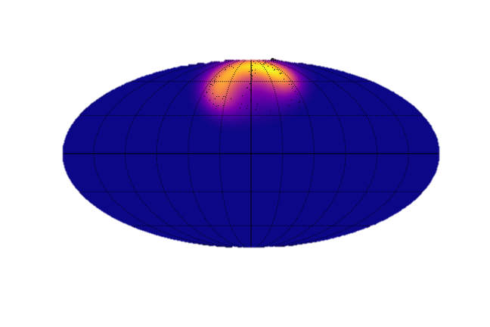
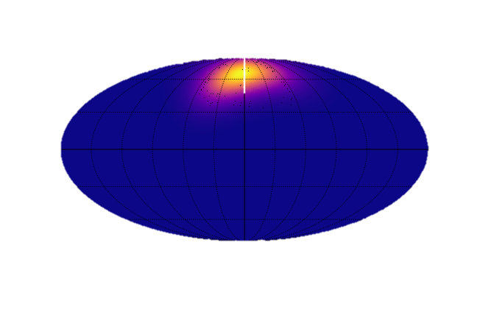
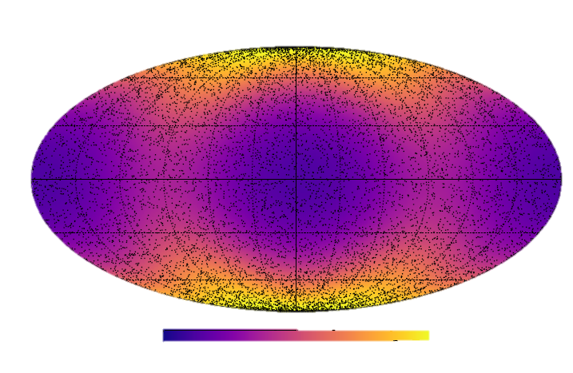
FB5 to FB8
03
FB8 Distribution
$${FB}_{8}(κ=155.5,β=83.9, η=−0.9, \vec{ ν}= (1, 0.003,−0.02))$$
$${FB}_{5}(κ=14.4, β=2.7)$$
180º
-180º
180º
-180º
0
0.19
0
0.11
Compare FB5 and FB8. An improved distribution can be seen in FB8.
And the error was also lowered.
Notes:
= c_8(\kappa, \beta, \eta,\vec{v})^{-1} exp\{\kappa\vec{v}\space\Gamma^{T}\vec{x}+\space\beta[(\vec{\gamma_2}\vec{x})^2-\space\eta(\vec{\gamma_3}\vec{x})^2]\}

Slide 13
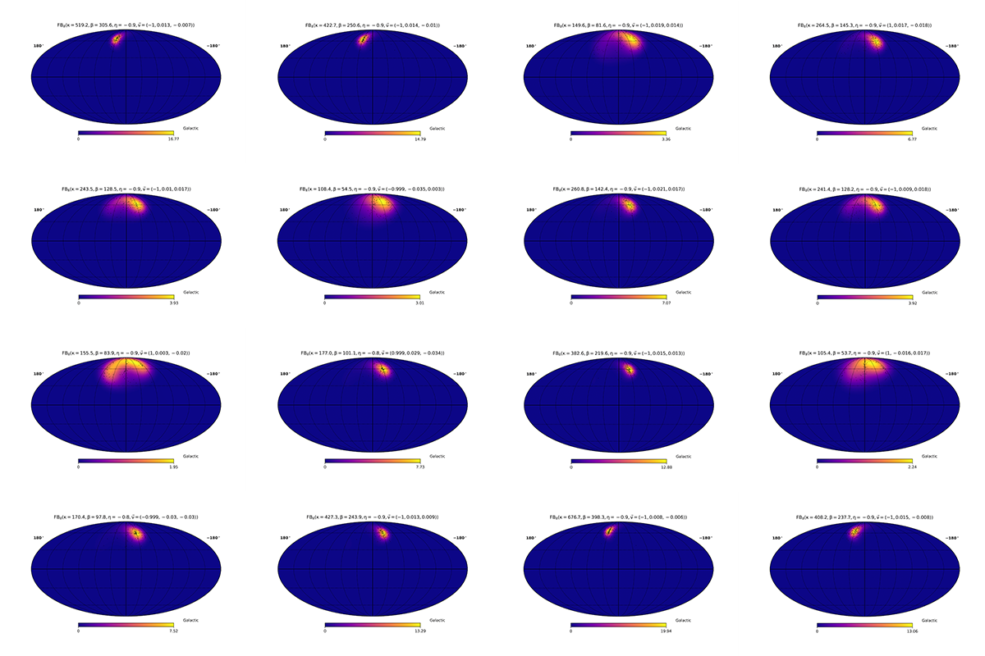
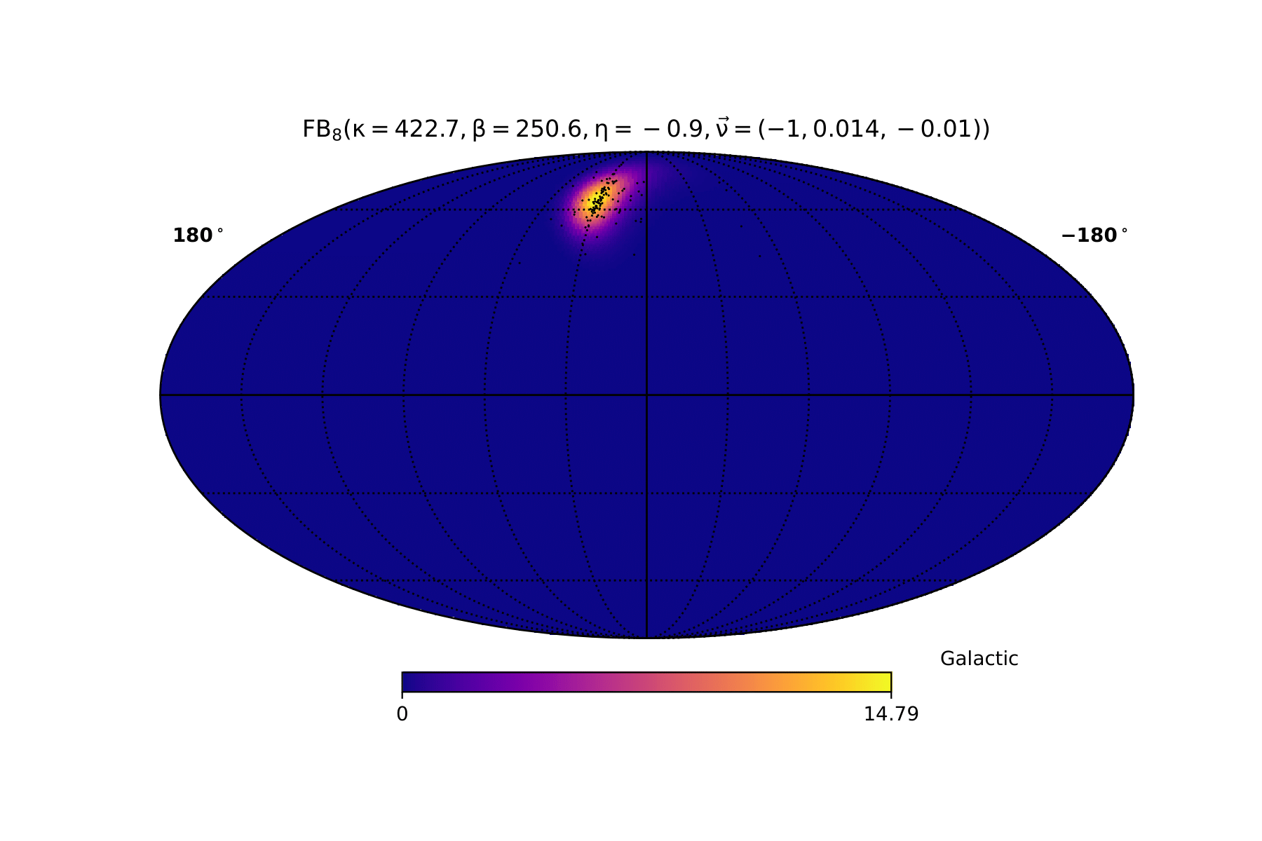
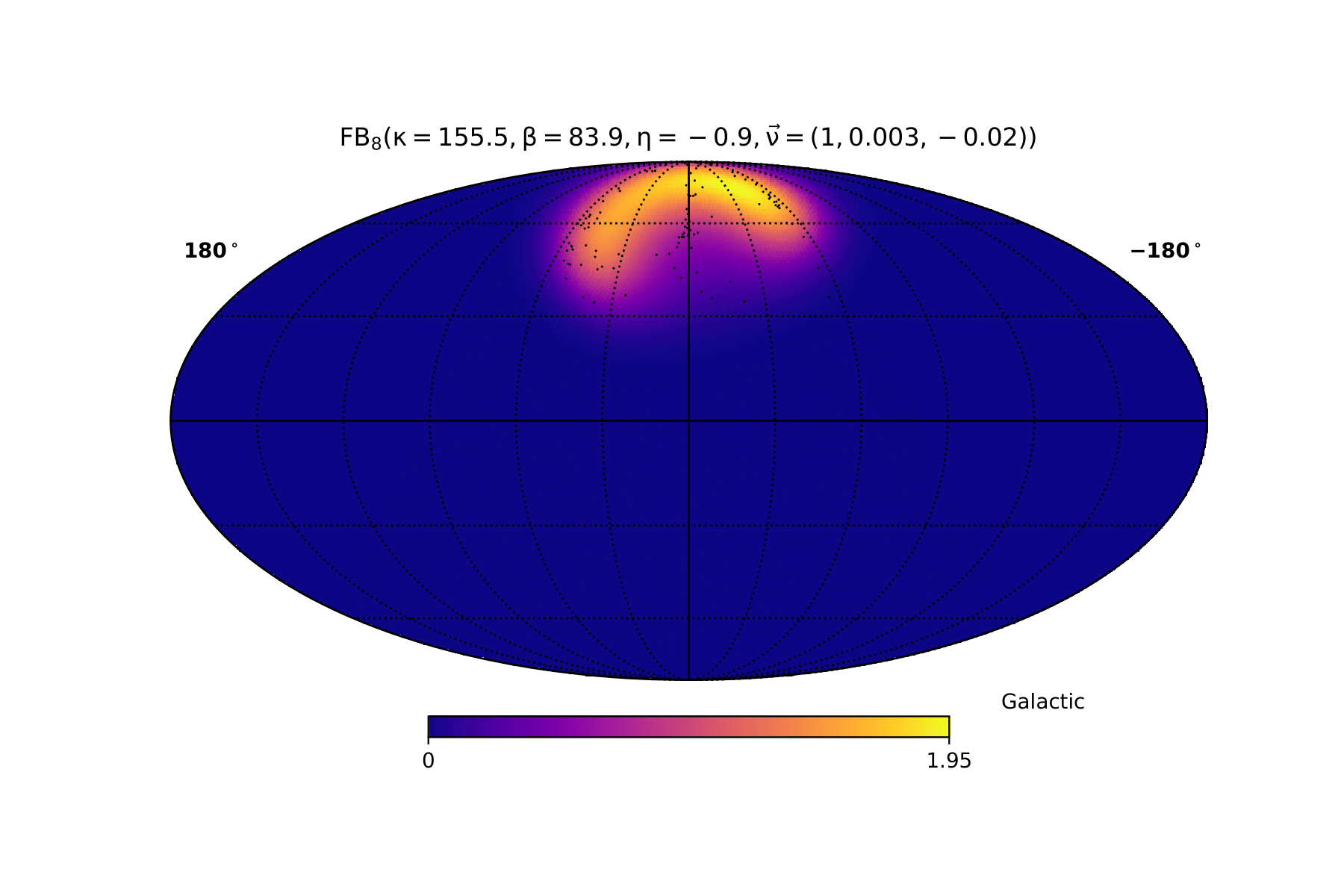
04
Pose Rareness

Slide 14
04
Pose Rareness
1. FB8을 이용하여 Rare한 Pose를 찾는다.
2. Rare Pose들을 Dataset에 집중학습 시키면 성능을 높일 수 있다.

